Slide 1
Unit 4- Lecture 24
Advanced planning methods
GraphPlan
The planning graph
Mutex relations

Slide 2
Advanced planning methods
Planning problems are often described by a Planning Domain Description Language (PDDL).
The PDDL allows one to write a set of predicates that describe the domain and operators that describe the actions that are possible.
A planning problem is an initial state description and a set of goal predicates that a solution plan is required to satisfy.
The task of planning is to find a solution plan.
The simplest plans are sequences of actions, and the most direct approaches to planning are search algorithms to find those action sequences.
In Chapter 7, There was a study of some of the search based planning algorithms for the simplest domains.

Slide 3
The simplest domains described in PDDL1.0 have instantaneous deterministic actions making the only changes in a completely observable domain, and the goal predicates specify conditions on the final state.
One of the reasons why planning research confined itself to the STRIPS domain is that even for these domains, the basic search algorithms were bogged down by combinatorial explosion.
This chapter looks at some of the techniques that increased the length of plans that could be found by an order of magnitude.
Included amongst these are methods to adopt a two stage approach in which the problem is transformed into a structure that circumscribes the space of search, and domain-independent, heuristic estimation methods.

Slide 4
In particular, let us look at planning with durative actions, and look at approaches for problems with trajectory and soft constraints.
Let us begin with the algorithm Graphplan that probably heralded these advanced planning methods.

Slide 5
GraphPlan
The algorithm Graphplan presented by Avrim Blum and Merrick Furst takes a very different view of the planning problem.
Instead of searching for a solution either in the state space or the plan space, it first constructs a structure called a planning graph that captures all possible solutions and then proceeds to search for a solution in the planning graph.
The Graphplan algorithm, as described by Blum and Furst, works in the STRIPS domain.
An action is applicable in a state if its preconditions are true in the state.
Negative preconditions cannot be handled.
The action may have both negative and positive effects.

Slide 6
Negative effects delete propositions from the state, and positive effects add propositions.
Figure in next slide shows the basic difference between the state space for a planning problem and the corresponding planning graph.
State space search applies an action to a given state and generates a successor state, as shown on the left.
For each action that is applicable, it generates a separate candidate state, which will be a starting point for further exploration.
In the figure, we assume two actions a₁ and a₂ that are applicable, with the preconditions linked by edges.

Slide 8
The planning graph is a layered graph made up of such alternating sets of action layers and proposition layers.
This is in contrast to the search tree of states that state space search generates.
The planning graph is a structure, as shown on the right, which merges the states produced by the different actions that are applicable.
The resulting set of propositions forms a layer, as does the set of actions that resulted in this layer.

Slide 9
Let us look at a concrete example from the blocks world domain.
The figure in next slide below depicts the action layer and the fact layer for a state containing three blocks.
One can see that there are propositions in the new layer that cannot hold together.
For example, On(A, B) and Hold(A) cannot be true at the same time, and therefore cannot be part of a state.
Likewise, On(A, B) and Clear(B), OnT(C) and Hold(C) cannot be a part of a state as well.

Slide 11
We can also see State space that the two actions in the action layer, PkUp(C) and UnSt(A, B), cannot happen at the same time, given the blocks world assumption of a one armed robot.
Propositions in one layer that cannot be true simultaneously and actions in a layer that cannot happen simultaneously define a binary relation called mutex in each layer.
The mutex relation, which stands for MUTual EXclusion, can be shown in the planning graph as edges connecting nodes in a layer.
Another question one might ask is about the delete effects of actions.
In the above example, the PkUp(C) has a delete effect OnT(C).

Slide 12
Should the proposition be allowed in the next layer? The answer is yes, because if the first action in the plan were to be UnSt(A, B), the resulting layer would have OnT(C).
This is the Frame Problem turning up again, and the way it is solved is by introducing a special action called No-op(P) for every proposition P.
The No-op(P) action has preconditions {P} and effects (P).
It basically serves to preserve every proposition.
To account for the relation between actions and their effects, we introduce edges between the action in a given layer and each of its effects in the next (proposition) layer.
These edges are of two kinds, one for the add effects and the other for the delete effects.

Slide 13
A proposition node may have both a positive edge and a negative edge coming in from different actions.
Only one, though, can be part of a valid plan.
The Planning Graph
A planning graph, therefore, is a layered graph consisting of alternating layers of proposition and action nodes (P0, A1, P1, A2, P2, A3, P3, An, …, Pn).
For every proposition pЄPi, there is a special action called No-op(p) ЄA_{i+1} that carries forward p to P_{i+1}.
There are four kinds of edges between nodes.

Slide 14
A precondition edge <p_{i}, a_{i+1}>, linking the precondition p_{i} to an action a_{i+1}. These are depicted by solid lines in our figures.
A positive edge <a_{i}, p_{i}>, linking an action a; to an add effect p_{i} of a_{i}. These are also depicted by solid lines in our figures.
A negative edge <a_{i}, p_{i}>, linking an action a_{i} to a delete effect p_{i} of a_{i}. These are depicted by solid lines with rounded heads in our figures.
A mutex edge linking two propositions in the same layer, or two actions in the same layer. These are depicted by thick dotted lines in our figures.
The planning graph is made up of the following sets associated with each index
The set of actions Ai in the ith layer.
The set of propositions Pi in the ith layer.

Slide 15
The set of positive effect links PostP_{i} of actions in the ith layer.
The set of negative effect links PostN_{i}, of actions in the ith layer.
The set of preconditions links PreP_{i} of actions in the ith layer from P_{i-1}.
The set of action mutexes in the ith layer.
The set of proposition mutexes in the ith layer.
Figure in next slide illustrates the structure of a planning graph.
The initial state of the planning problem defines the layer P₀.
Since P₀ represents a given state, there can be no mutex edges in this layer.
In the graph shown below, there are four actions—a1, a2, a3 and a4.

Slide 17
An action appears in a layer, only if all its preconditions are nonmutex in the previous proposition layer.
The first two actions a1 and a2 appear in the first action layer A1, and the other two appear in layers A2 and A3 one by one.
For every proposition, there is a No-op action shown in dashed edges in the figure.
Only some of the mutex edges have been shown to avoid cluttering up the figure.
Very often we do not show the No-op actions explicitly in the planning graph figures.
Instead, we draw edges directly from the proposition in one layer to the proposition in succeeding layers.

Slide 18
These are depicted as thick, dashed, grey lines in the figure in next slide.
Next figure depicts a few layers of a planning graph for a simple blocks world problem.
Observe that the planning graph does not depend upon the goals to be solved in a specific planning problem.
One of the first observations one can make is that the nodes in the graph grow monotonically with every new layer.
This is because every proposition has an associated No-op action.
Once a proposition appears in a layer, it will always occur in subsequent layers.

Slide 20
It is a little less obvious, but when an action appears in an action layer, it occurs in every subsequent layer as well.
This is because its preconditions that appeared nonmutex in a layer continue to show up nonmutex in subsequent layers.
More interestingly, the proposition layers and action layers in a planning graph stabilize or level off after a while.
Once the graph has levelled off, no new propositions or actions will appear.
However, the number of mutexes may still change.
In the starting layer, there are no mutexes.
But as the graph is built, mutexes appear.
However, these mutexes could disappear in future layers.

Slide 21
Once they disappear, they can never appear again.
Consider the blocks world problem in which two blocks, say A and B, that have to be unstacked from two blocks, say C and D respectively, and are to be put on the table.
In the first action layer, there will be two actions, UnSt(A, C) and UnSt(B, D), with effects Hold(A) and Hold(B) in P1.
These actions and their effects will naturally be mutex since only one block can be picked up by the one armed robot.
In the next level A2, there are two actions PtDn(A) and PtOn(B), resulting in propositions OnT(A) and OnT(B) in layer P2.
Again, it is easy to see that these propositions are mutex in P2.
However, with two more layers of actions and propositions, the two propositions OnT(A) and OnT(B) are not mutex in the layer P4.

Slide 22
Mutex Relations
The plans produced by Graphplan may have actions that occur in the same layer.
This means that they could be done in parallel without affecting the outcome.
Moreover, if one wants linear plans then these actions could be linearized in any order.
The mutex relations identify a pair of actions or propositions that cannot be present in the same layer in a plan.
Two actions a ЄAi and bЄAi are mutex if one of the following holds,
Competing Needs
There exist propositions p_{a}Єpreconditions(a) and p_{b}Єpreconditions(b) such that pa and pb are mutex (in the preceding layer).

Slide 23
Inconsistent Effects
There exists a proposition p such that pЄeffects⁺(a) and pЄeffects⁻(b) or vice versa. The semantics of these actions in parallel are not defined. And if they are linearized then the outcome will depend upon the order.
Interference
There exists a proposition p such that pЄpreconditions(a) and pЄeffects⁻(b) or vice versa. Then only one linear ordering of the two actions would be feasible.
There exists a proposition p such that pЄpreconditions(a) and pЄeffect⁻(a) and also pЄpreconditions(b) and pЄeffect⁻(b). That is, the proposition is consumed by each action, and hence only one of them can be executed. This condition can be seen as a special case of the condition 3 in which neither linearization is allowed.

Slide 24
Two propositions pЄPi and qЄPi are mutex if all combinations of actions <a, b> such that aЄai and bЄAi and pЄeffect⁺(a) and qЄeffect⁺(b) are mutex.
Observe that if two propositions are not mutex in a layer, they will be not mutex in all subsequent layers because of the No-op actions.

Slide 25
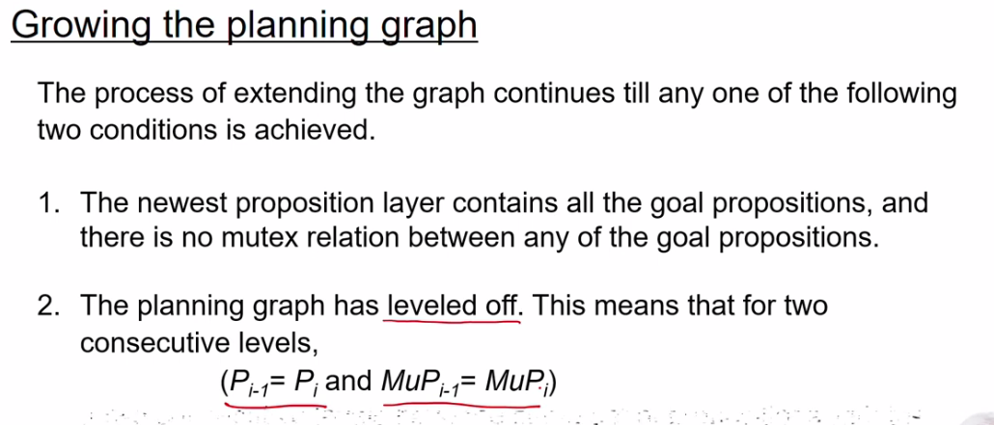

Slide 26
